Slide 1

Introduction to Machine Learning Topic 2 – Resampling methods and Fine-tuning (ISL Ch. 3 / HOML Ch. 2 / IMLP Ch. 5)
Master in Quantitative Economic Analysis MQuEA
Javier Bas
Universidad Autónoma de Madrid
2022/2023

Slide 2
Outline
Resampling methods
Validation set
Leave-one-out cross validation (LOOCV)
k-fold cross-validation
Bootstraping
Fine-tuning
Grid search
Randomized search
Master in Quantitative Economic Analysis MQuEA
Universidad Autónoma de Madrid

Slide 3
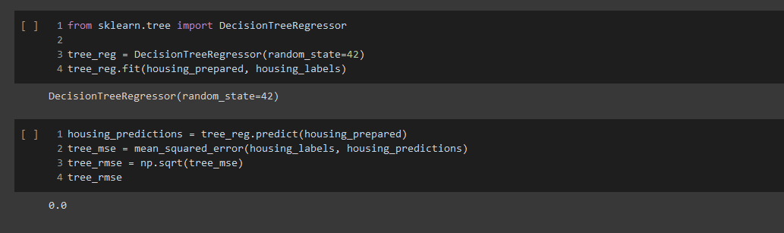
Resampling methods
Remember the goodness of fit of the Decision Trees method in Notebook 2?
Is the model performing PERFECTLY? Nope, it is badly overfitting the data!
Master in Quantitative Economic Analysis MQuEA
Universidad Autónoma de Madrid

Slide 4
Resampling methods: the validation set
One better way to evaluate a model is to split the training dataset into a training and a validation dataset.
We estimate the error by holding out a subset of the training observations from the fitting process, and then applying the model to those held out observations.
The process is as follows:
Training/Test split: This is done at the very beginning of the workflow
Training/Validation split: The training dataset is further split once again into training and validation
Train the model in training
Validating the model in validation
Master in Quantitative Economic Analysis MQuEA
Universidad Autónoma de Madrid

Slide 5
Resampling methods: The validation set
The validation set approach has an important drawback: The validation error can be highly variable, depending on which observations are included in the training/validation set.
1 single split intro training and validation
Validation method repeated 10 times
Master in Quantitative Economic Analysis MQuEA
Universidad Autónoma de Madrid

Slide 6
Resampling methods: Leave-one-out CV
Like the validation set approach, LOOCV involves splitting the set into two subsets, but not of similar size. Just a single observation is held out and used for validation.
The algorithm is estimated on the n-1 training observations, then a prediction is performed in the excluding observation.
Master in Quantitative Economic Analysis MQuEA
Universidad Autónoma de Madrid

Slide 7
Resampling methods: Leave-one-out CV
Therefore, the model is estimating n times, leaving aside in each iteration a different observation.
Then the error is calculated as the average of all errors.
Master in Quantitative Economic Analysis MQuEA
Universidad Autónoma de Madrid

Slide 8
Resampling methods: Leave-one-out CV
LOOCV has major advantages over the validation set approach:
The validation approach yields different results when applied repeatedly (i.e defining different training/validation partitions) because the observations are selected randomly.
However, performing LOOCV multiple times always provide the same results since there is no randomness in the process of splitting the data.
But it also has a drawback:
It is expensive to implement (the model is fit n times)
Master in Quantitative Economic Analysis MQuEA
Universidad Autónoma de Madrid

Slide 9
Resampling methods: k-fold CV
The set of observations is randomly divided into k groups, or folds, of equal size.
The first fold is treated as a validation set, and the method is fit on the remaining k-1 holds.
The mean squared error is computed in the observations in the held-out fold.
This procedure is repeated k times, each time, a different group of observations is treated as a validation set.
This process results in k estimates of the test error, and the k-fold CV estimate is the average of these values.
This plot is read left to right
Master in Quantitative Economic Analysis MQuEA
Universidad Autónoma de Madrid

Slide 10
Resampling methods: k-fold CV
One advantage of using k = 5 or k = 10 (the usual values) instead k = n is computational
But there are also non-computational advantages. Some variability occurs in CV estimates due to the variability on how the observations are divided into ten folds. But it is typically lower than the variability resulting from the validation set approach.
Master in Quantitative Economic Analysis MQuEA
Universidad Autónoma de Madrid

Slide 11
Bootstraping
Bootstrapping is a method of inferring results for a population from results found on a collection of smaller random samples of that population, using replacement during the sampling process.
More specifically it is a method to quantify the uncertainty associated to an estimator; in practical terms, to estimate the standard deviation of our estimates
We repeatedly sample (with replacement) from the original data set and calculate estimators in each of those samples (bags). Those estimations are used to compute standard deviations, confidence intervals, etc.
Master in Quantitative Economic Analysis MQuEA
Universidad Autónoma de Madrid
Notes:
https://www.mastersindatascience.org/learning/machine-learning-algorithms/bootstrapping/

Slide 12
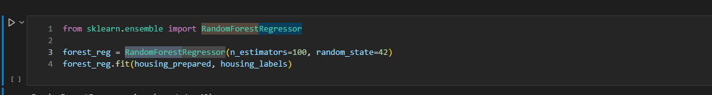
Fine-tuning
When estimate a model, we predefine certain parameters
Number of trees in a Random Forest or the maximum depth of a tree
Number of neurons in a Neural Network as well as number of layers
…
Those parameters are called hyperparameters. They cannot be learnt from the data. We need to experiment with several values for them in order to look for the better combination. This is called fine-tuning.
Master in Quantitative Economic Analysis MQuEA
Universidad Autónoma de Madrid

Slide 13
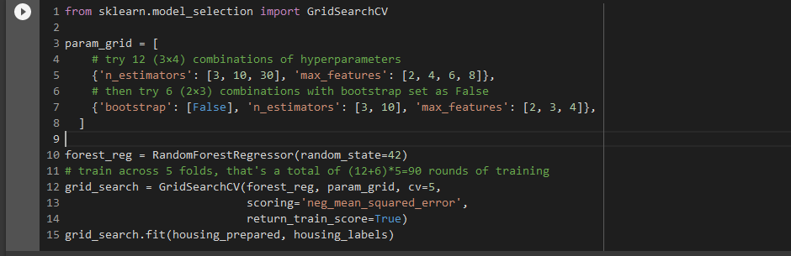
Fine-tuning: Grid search
Trying several hyperparameters manually until finding a good combination of these would be painful and maybe fruitless
However, we can define a range of values for each hyperparameter and make the algorithm fit a model for each combination of them
The best model is that with the best performance and will be used for testing.
3 x 4 + 2 x 3 = 18
5 times!
90 training rounds in total
Master in Quantitative Economic Analysis MQuEA
Universidad Autónoma de Madrid

Slide 14
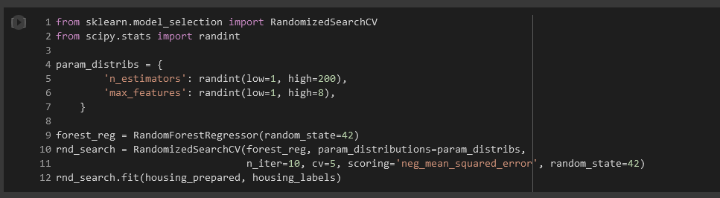
Fine-tuning: Randomized search
Grid search is fine when there are just a few combinations but… how do we know the specific values to try with?
Instead of evaluating all possible pre-defined combinations, Random Search makes the algorithm to evaluate a given number of random combinations by selecting a random value for each hyperparameter at every iteration (we indicate how many iterations).
Master in Quantitative Economic Analysis MQuEA
Universidad Autónoma de Madrid

